Slide 1
SMART IRRIGATION SYSTEM
An automatic plant watering system

Slide 2
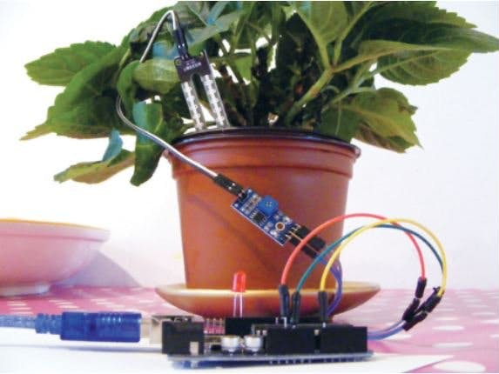

Slide 3
Introduction
A plant watering system that provides water to plants whenever required.
We find it difficult to water plants at times when we are away from homes. So this is a solution we found for this problem using arduino.

Slide 4
Description
In automatic plant watering system or we can say it smart irrigation system. we are using an arduino microcontroller to control and sense the thing in the projects such as sense or measure the moisture in the soil we are using soil moisture sensor. soil moisture sensor is sensor which vary the value when it contact to the moisture. basically it is a resistor which works on moisture condition. when the moisture is more then the value of resistance will decrease and when the moisture is less then the resistance value is more. so we have to first calibrate the sensor into the different moisturing condition of water. you can check it into the water also. so now you have some value from the different conditions. Now, you can make the code according to the value. put these values in the if condition of code. and this if condition decide the pump will work or not.

Slide 5
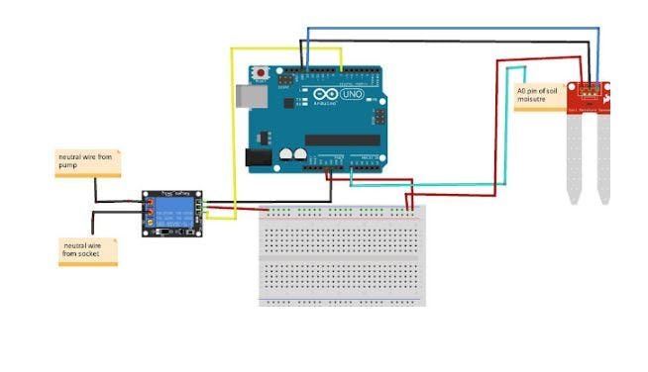
Circuit Diagram

